Slide 1

Brainstorming
Blessy Kuriakose
CSCE 5200.002 – (Information Retrieval)
February 10, 2023

Slide 2
Brainstorming
Query search engine
(?) UNT Undergrad course flow chart based on prerequisites. Include live recommendations based on scheduling (time and location).
Recommendation system
Recipe recommendation based on customer clustering on ratings. Involve recipe/ingredient classifications? (https://www.kaggle.com/datasets/shuyangli94/food-com-recipes-and-user-interactions?select=interactions_train.csv)

Slide 3


RECIPE RECOMMENDATION SYSTEM
Recipe retrieval by ingredient listing with ranking by customer preference clustering.
Possible dataset: https://www.kaggle.com/datasets/shuyangli94/food-com-recipes-and-user-interactions
Possible implementation:
Getting all recipes that can be made with the ingredients specified in a user inputted list.
Finding most common ingredients (ranked) –for use in cases where the user inputted ingredients list is insufficient for any recipes in the database.
Preference grouping based on keywords from prior reviews and ratings of recipes in database –given user id of person using the system. (single user or user cluster.)
Ranking recipes under consideration using the preferences, with the average recipe rating as a secondary fallback when ordering.

Slide 4
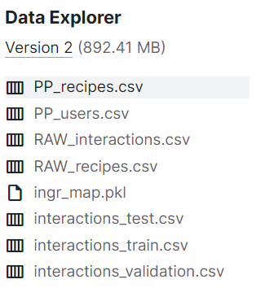
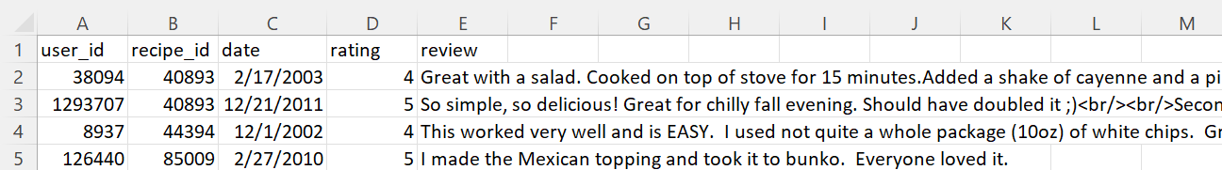
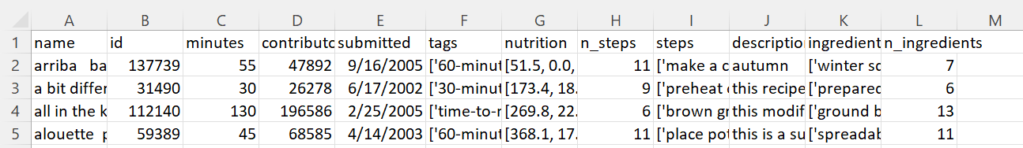
About the (tentative) dataset
180K+ recipes and 700K+ recipe reviews covering 18 years of user interactions and uploads on Food.com

